Slide 1

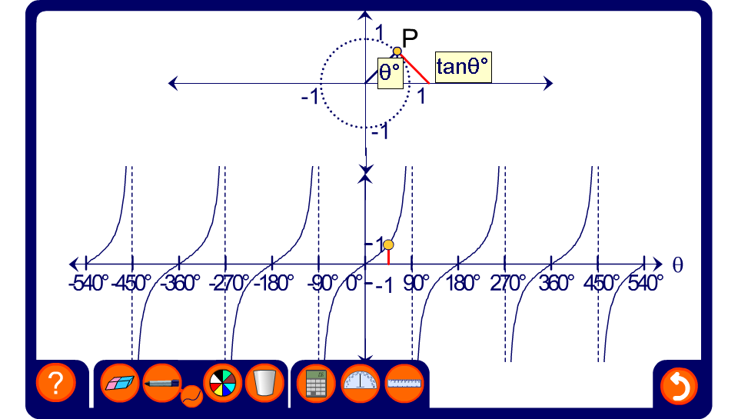


The graph of tan θ
Notes:
Trace out the shape of the tangent curve and note it properties.
The curve repeats itself every 180°.
Tan θ is undefined at 90° (and 180n + 90° for integer values of n).

